Slide 1




www.nimeshshrestha.com.np
NEURAL NETWORK 404
Understanding Machine Learning !
Presented By:
Nimesh | Sujan
🧑‍💻
This Photo by Unknown Author is licensed under CC BY-SA

Slide 2

Abstract
Today, we’ll overview machine learning, a part of AI that develops algorithms to learn from data and enhance performance over time. We’ll discuss its importance in technology, applications across industries, challenges, and future potential. We’ll review key findings from recent research and highlight innovation opportunities.

Slide 3
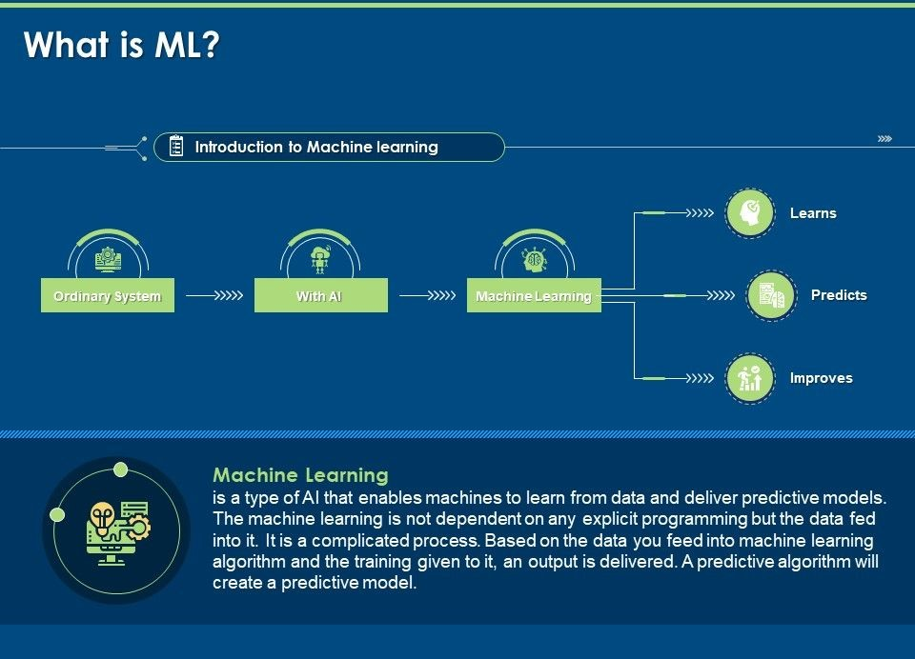

Slide 4

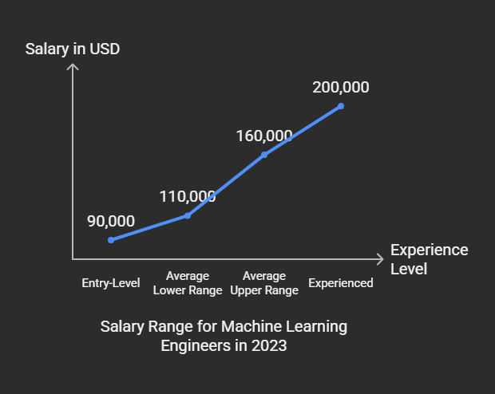
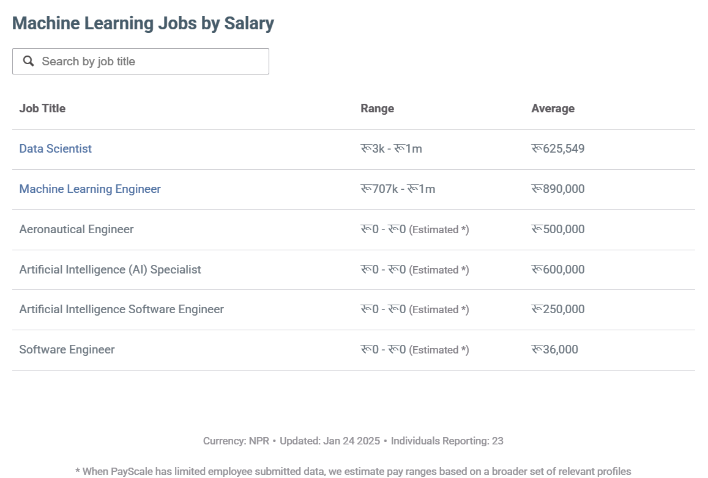
TRENDS , SCOPE & SALARY OF ML , AI EXPERTS

Slide 5
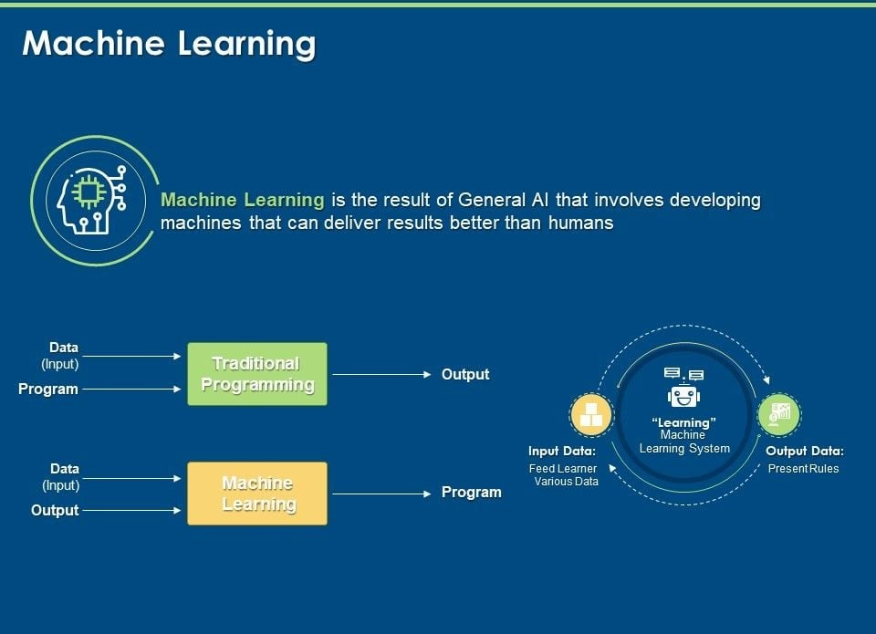

Slide 6

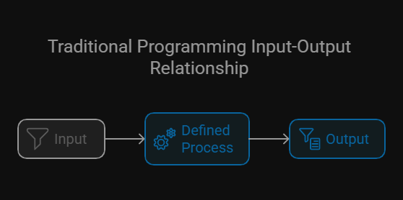
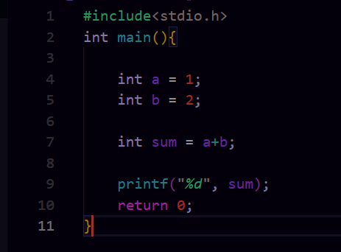
How does Traditional Programming Works?

Slide 7
HOW DOES MACHINE LEARNING WORKS?
INPUT |  | OUTPUT
A ( LET’S SAY OLD DATA) | B(LET’S SAY NEW DATA) | AxB
2 | 1 | 2
2 | 2 | 4
2 | 3 | 6
2 | ? | 8
? | 5 | 10
? | ? | 12
OLD DATA
NEW DATA
TRAINED
CRITICAL ANALYSIS
+
₌

Slide 8

OBJECTIVE OF ML
Automate Decision-Making:
Automating spam detection in emails or fraud detection in financial transactions.
2. Enable Predictive Analytics:
Predicting stock prices, or disease outbreaks.
3. Enable Real-Time Decision-Making:
Autonomous vehicles making real-time driving decisions or real-time fraud detection in banking.
4. Reduce Human Effort:
Automating customer support with chatbots or automating data entry tasks.

Slide 9
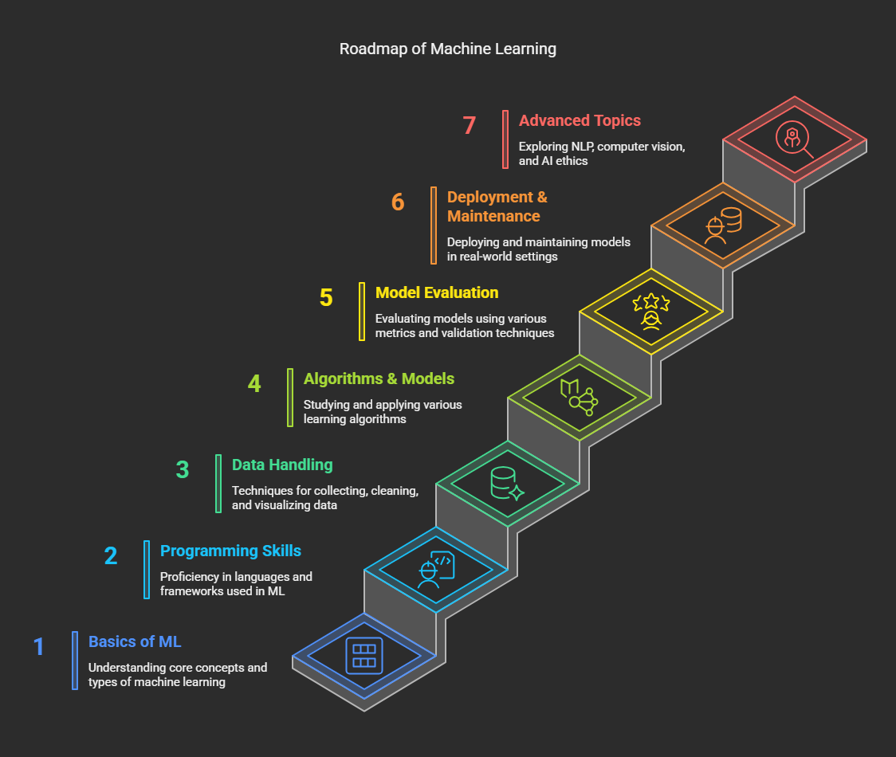

Slide 10
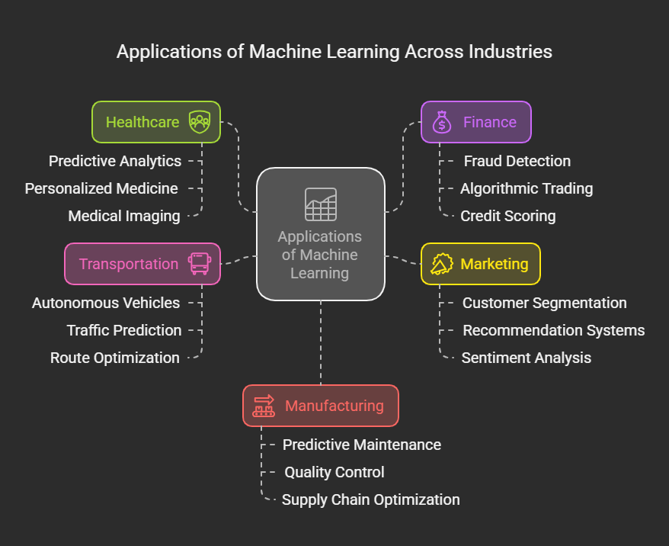

Slide 11


Object Detection
Object detection in computer vision involves identifying and locating specific objects within an image, unlike image classification which only classifies the overall image.
This Photo by Unknown Author is licensed under CC BY-NC-ND

Slide 12
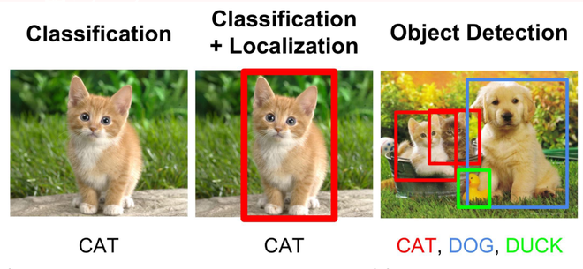
Image Classification:
Image Classification is the task of assigning a category or label to an entire input image, such as identifying if an image depicts a dog, car, or other object. It focuses on classifying the overall contents of an image, unlike related tasks like Object Detection or Semantic Segmentation.
This Photo by Unknown Author is licensed under CC BY-NC-ND

Slide 13

VIRTUAL TRY-ON
This Photo by Unknown Author is licensed under CC BY-NC-ND

Slide 14
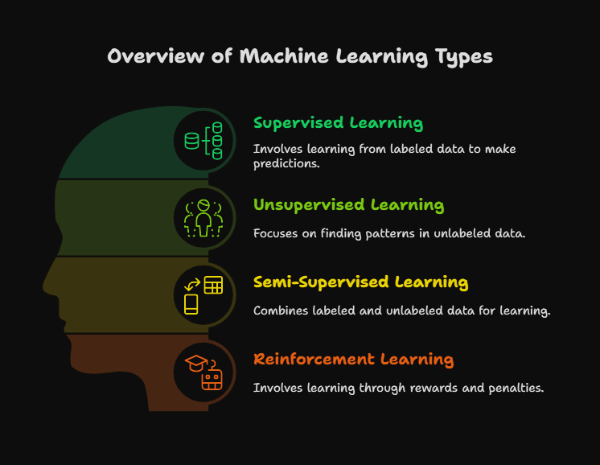

Slide 15
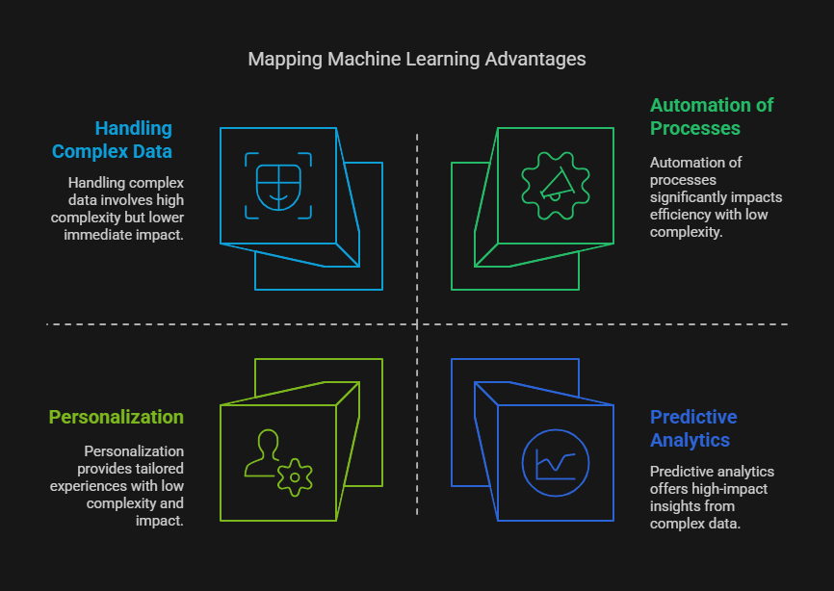

Slide 16
